Slide 1
Room Escape
By Bryan, Martin, Johannes, Laurent, Indira, Florentine
Notes:
Einleitung

Slide 2
Room-Escape
Brainstorming
Process
Graphics
Outcome

Slide 3
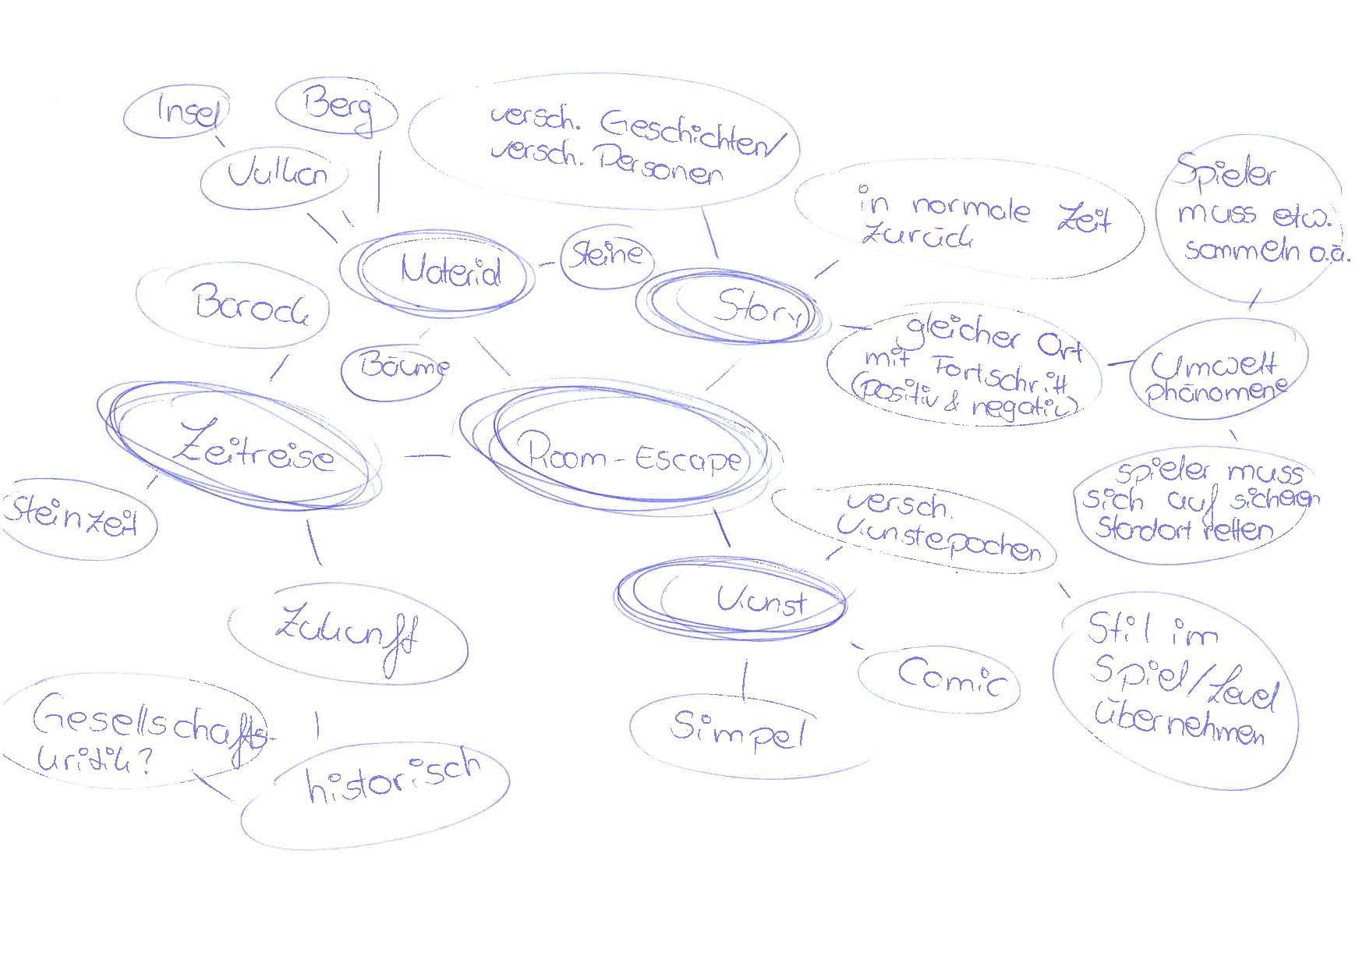
Room-Escape
Brainstorming
Notes:
Scan

Slide 4
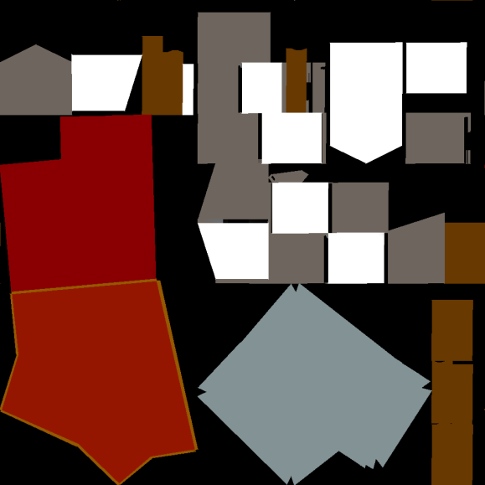

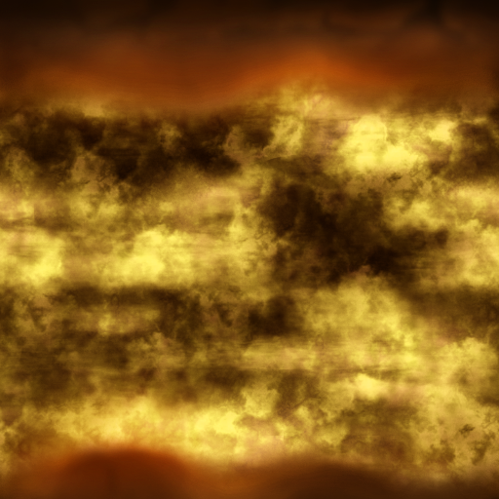

Room-Escape
Process
Notes:
Bilder
Haus
Vulkan

Slide 5
Room-Escape
Outcome

Slide 6
Thank you for listening!
Notes:
Ende

